Slide 1


FROM EXCEL TO
R

Slide 2






KU DATA SCIENCE LABS
WHO ARE WE?
1. Center for Health Data Science (HeaDS) - https://heads.ku.dk/
SUND Center, which includes a KU data lab
Thilde Terkelsen ¹
Diana Andrejeva ¹
Consultation & Collaboration:
Data science and bioinformatics analyses, e.g. big data, -omics analysis, machine learning.
Teaching; Courses & Workshops, Seminars, etc.
Tugce Karaderi ¹
Henrike Zschach ¹
2. ReNEW NNF Center for Stem Cell Medicine
3. Data Science Laboratory (DSL) - https://datalab.science.ku.dk/
Dep. of Math and Computer Science, Faculty of SCIENCE
Bo Markussen & Helle Sørensen
Adrija Kalvisa ²
1
Notes:
First time running this course. There will be an evaluation, please be patient with us, we are not quite sure how this will go :-)

Slide 3
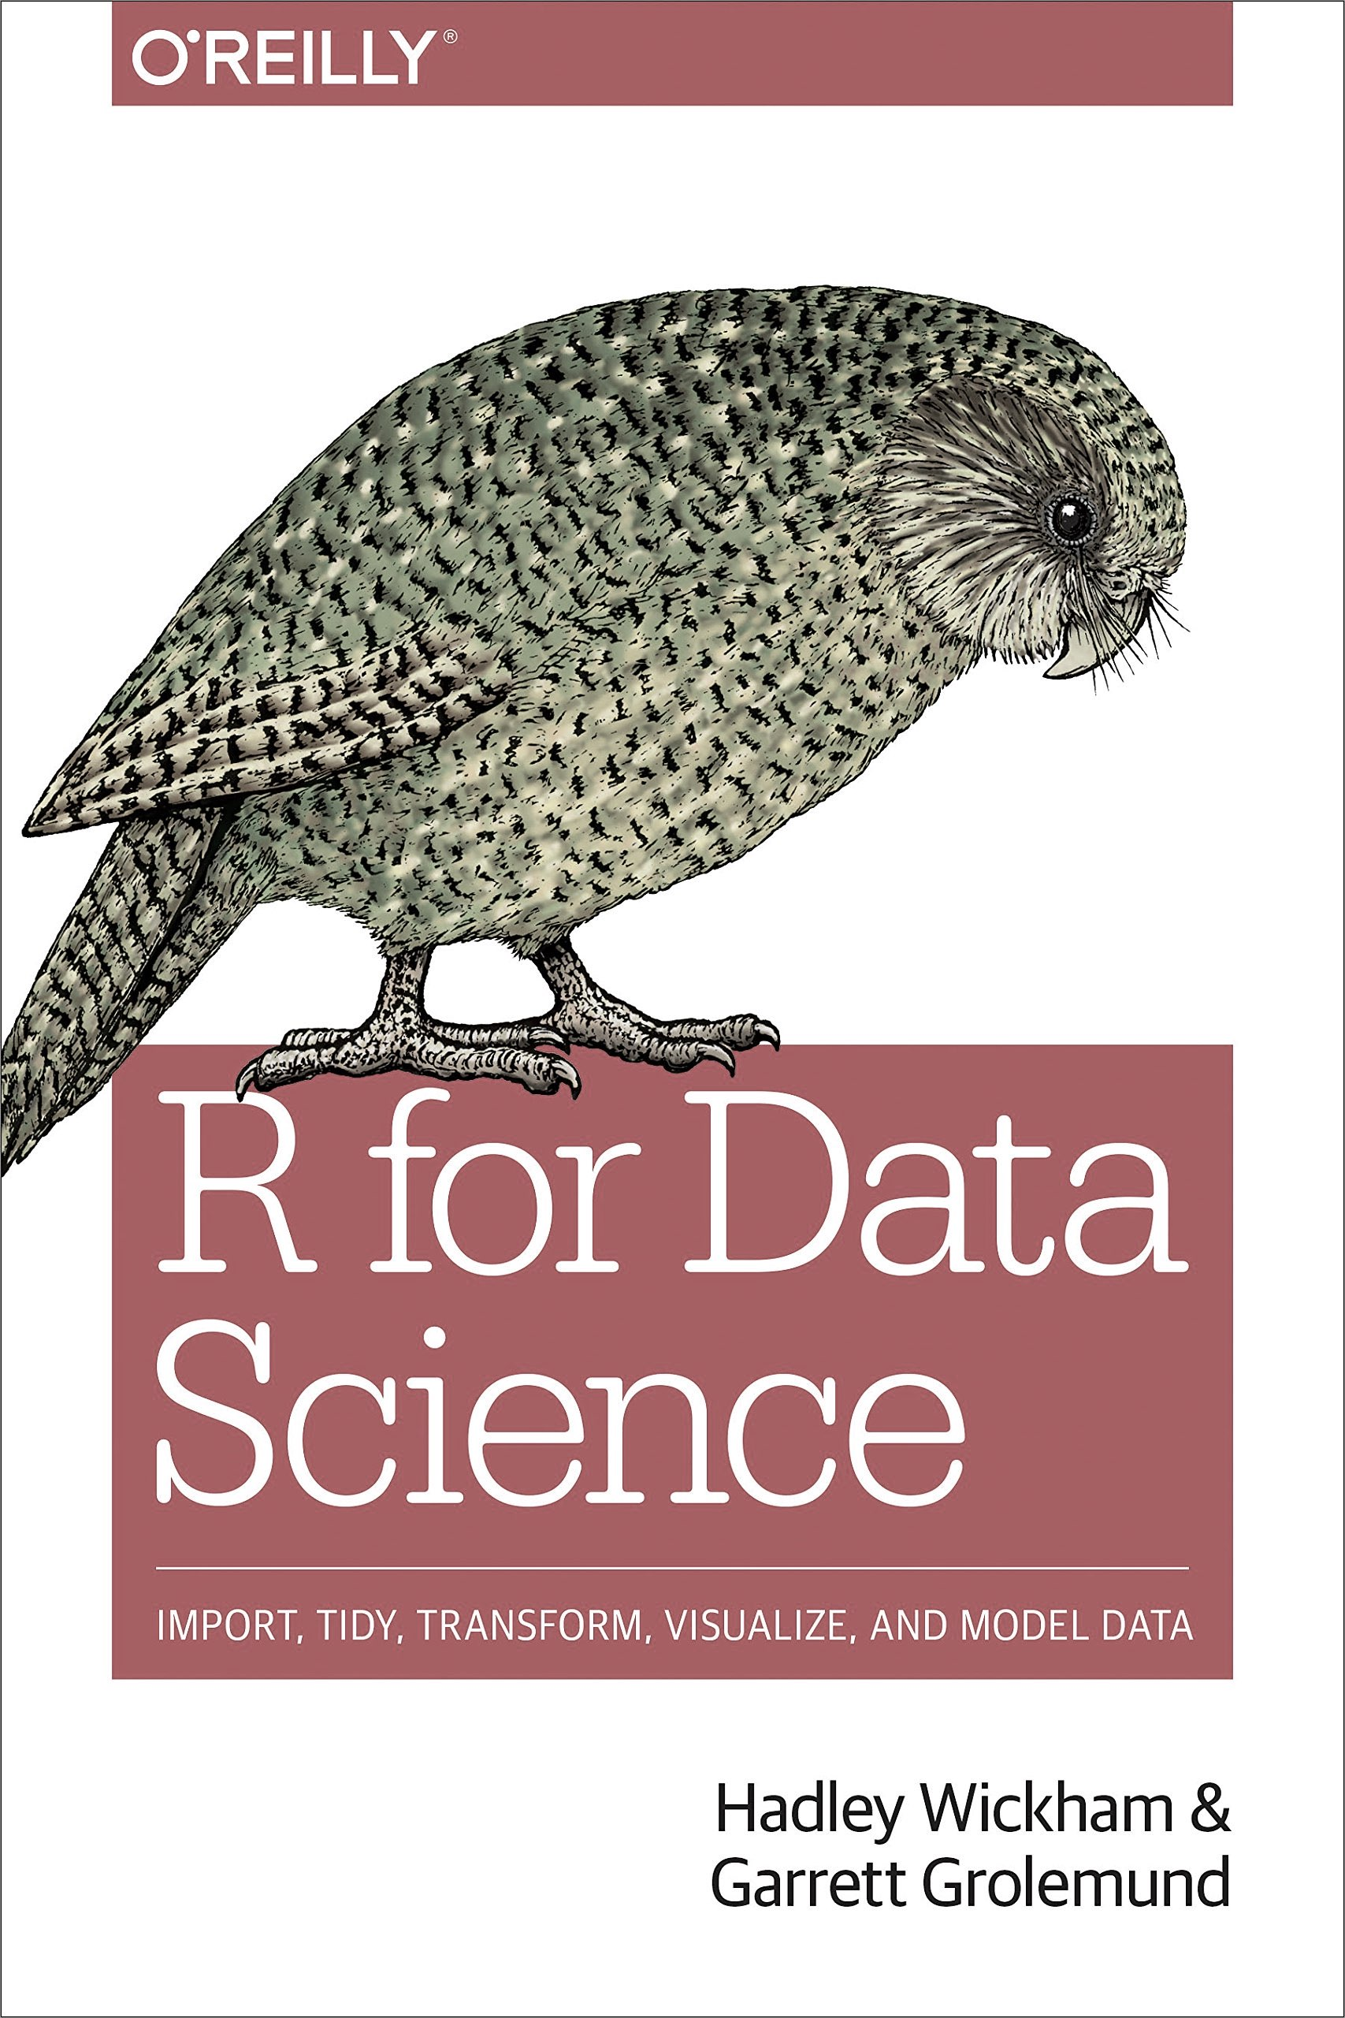
FROM EXCEL TO R
THE PRACTICALS
Two days: 9.00-16.30. There will be coffee breaks, we promise
“R for Data Science” - a generally useful book on R, also for this course
The course is build on hands-on presentations (.R, .Rmd) & exercises
Download and install the newest version of R (https://cran.r-project.org/)
Download and install the newest version of R-studio (http://www.rstudio.com/download)
Download the course material and place it somewhere you can find it again!
https://github.com/Center-for-Health-Data-Science/FromExceltoR
2

Slide 4

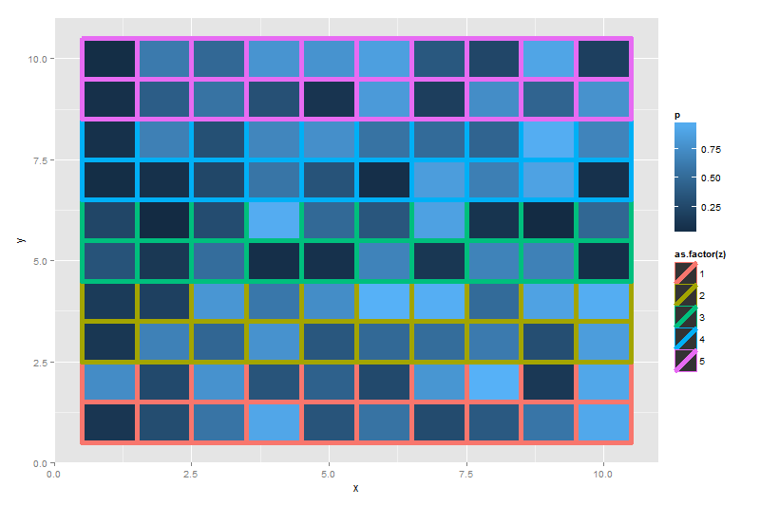
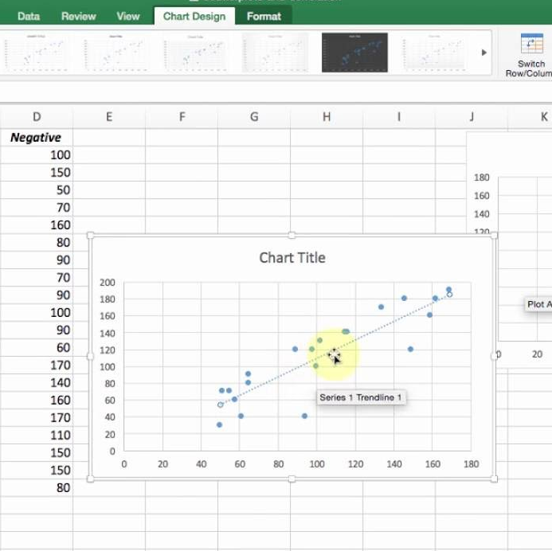
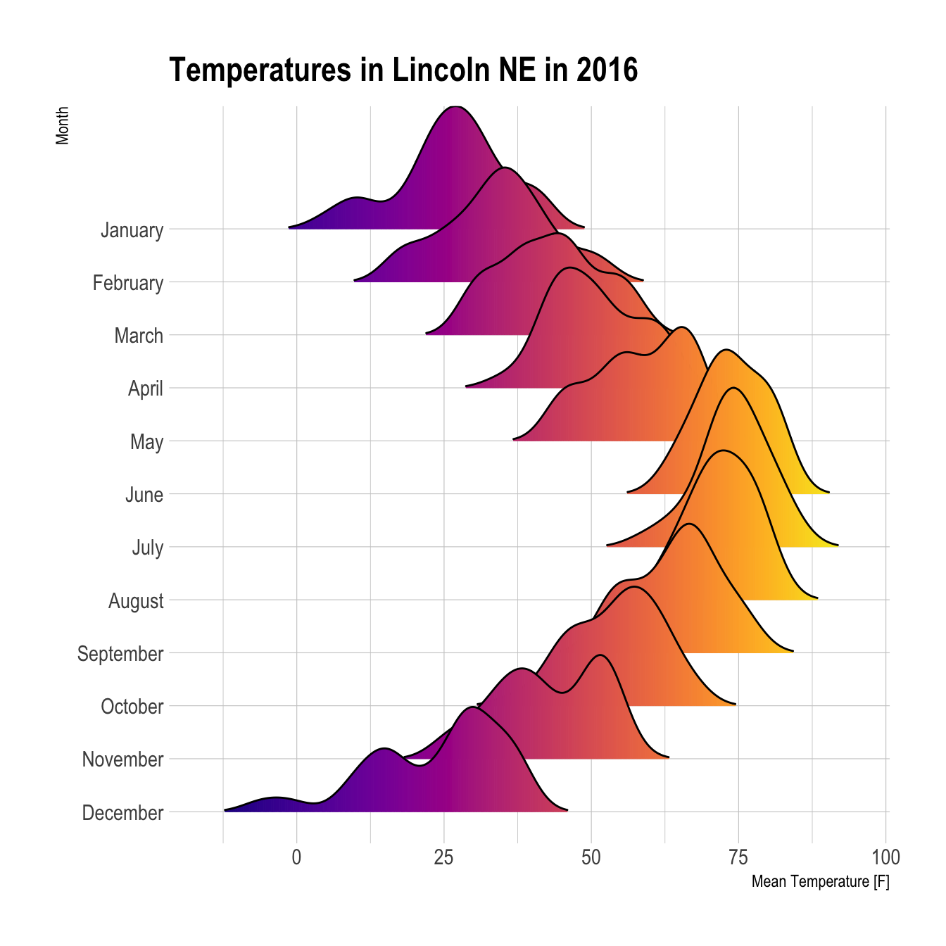
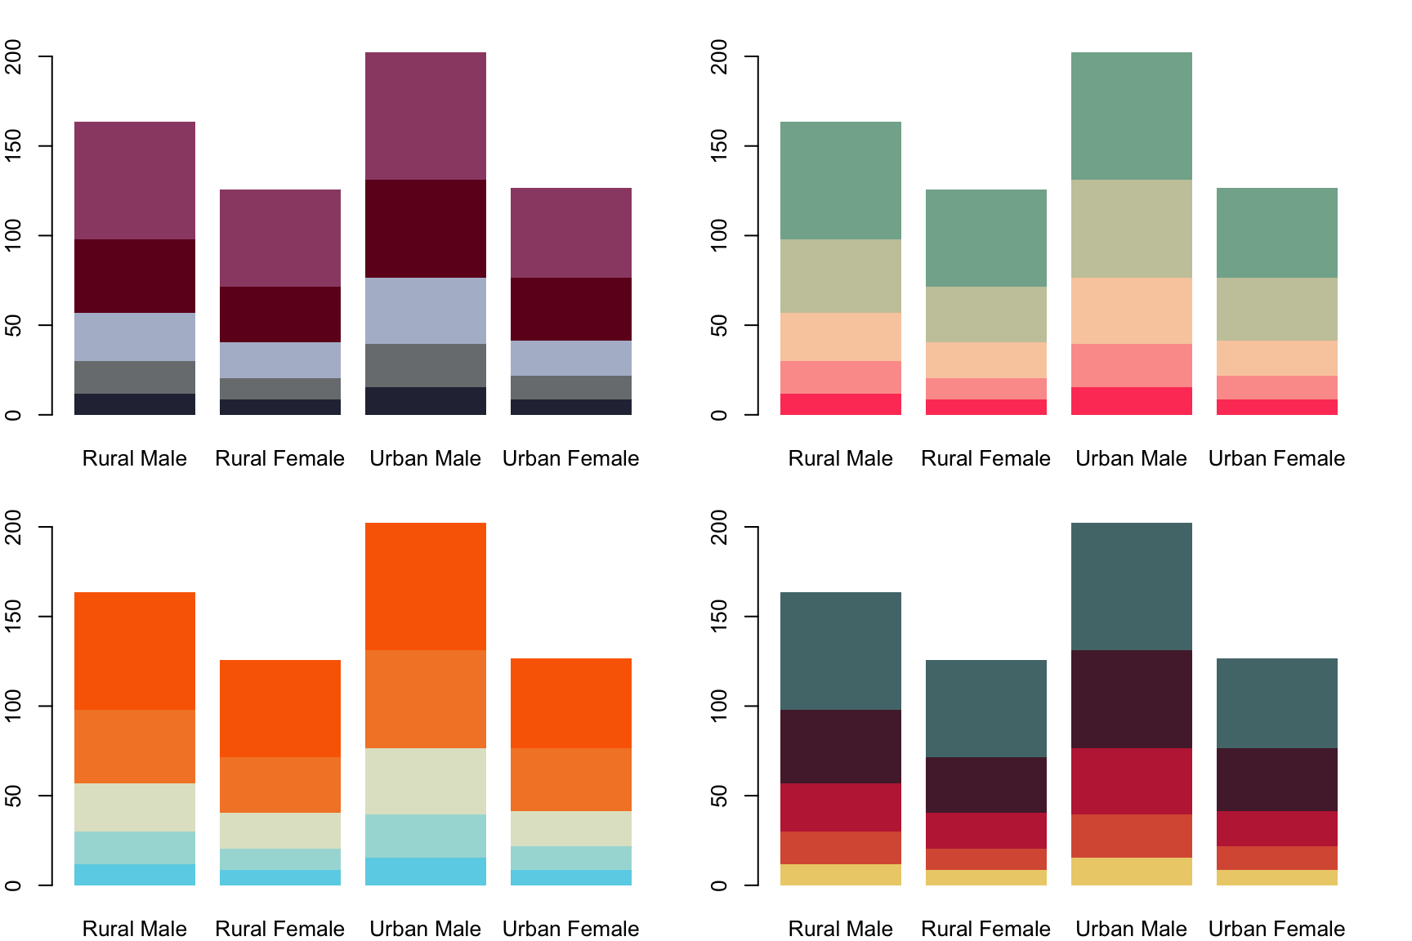
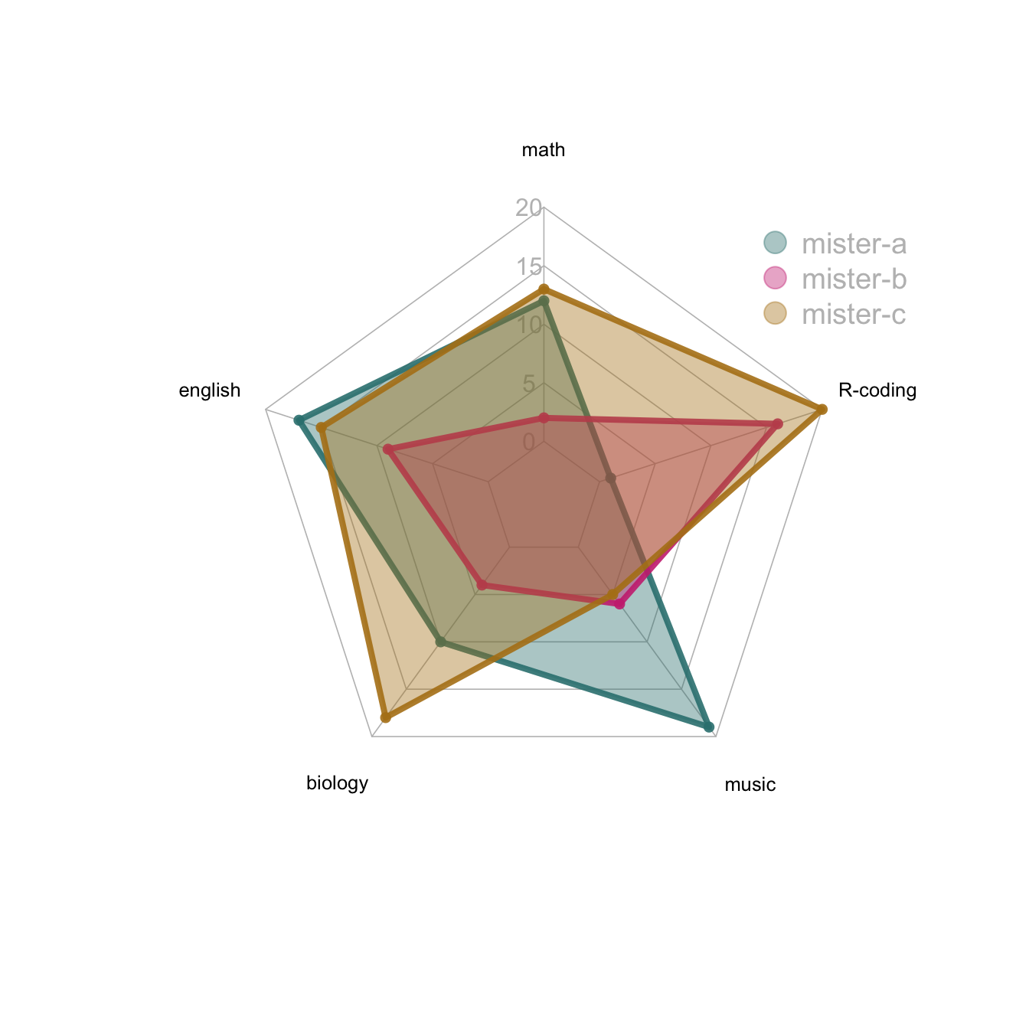
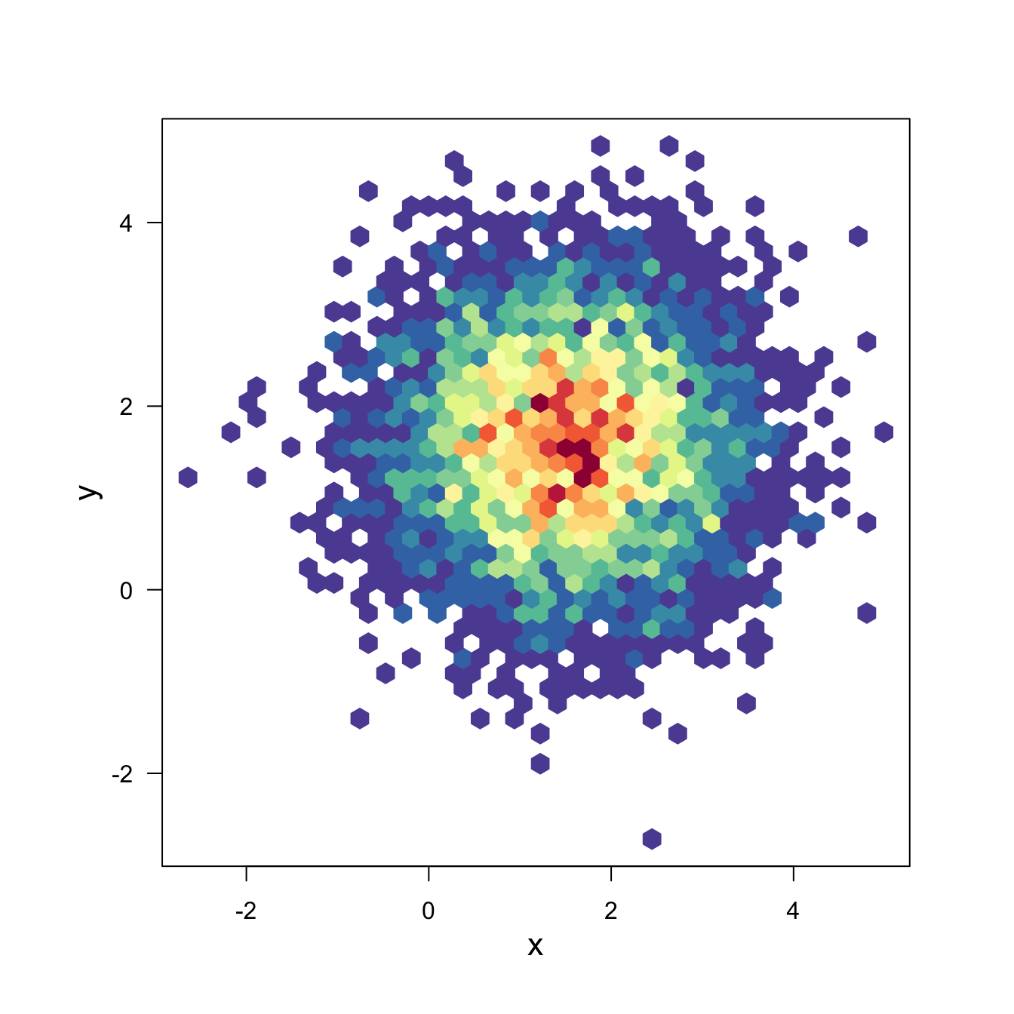
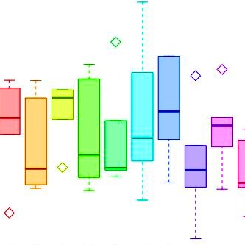
WELCOME TO
FROM EXCEL TO R
R
3

Slide 5
FROM EXCEL TO R
GRAPHICS
WHY R ?
Open Source
Easy to get started with:
Compatible with all systems, great support
Large Community:
R-packages, pipelines, tutorials, help pages
Flexible Language:
Plugins, git/github, R Shiny, Rmarkdown, …
Customisable Graphics
R has its limitations, but now fewer than ever
COMMUNITY
OPEN SOURCE
R
EASY START
FLEXIBLE
4

Slide 6
A COMPARISON
FROM EXCEL TO R
Max: 1000000 rows and 16000 cols
Upper limit of an object in R is 2^31
Limited to some operations
Super flexible, almost everything
Some Stats, mostly math
Stats/bioinf., etc. different fields
Okay for the basics
R
Highly customised plots
Cells are mutable - ‘bad’
Markdown, Git, shiny, etc.
Great for small/medium data
Big Dataset
Especially great for big data
Data Wrangling
Data Analysis
Plotting
Reproducibility
Quick Overview
5

Slide 7

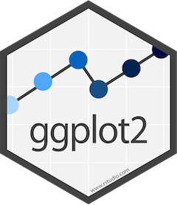

FROM EXCEL TO R
WHAT WILL YOU LEARN IN THIS COURSE?
DATA WRANGLING
PLOTTING
tidyverse
Data Structures
Useful Functions
Pipe (“clean” code)
ggplot2
Code structure
ggplot2 + tidy data
THE BASICS
REPRODUCIBILITY
R
R base syntax
R Studio
Scripts, paths, files
R project
Help recourses
R Markdown
Doc. types
Good practices
Other cool things
APPLIED STATISTICS IN R
6

Slide 8
FROM EXCEL TO R
PROGRAM
PLACE: Faculty of Health and Medical Sciences, Panum, Blegdamsvej 3B, 2200 København
DATES: Faculty 04-03 & 05-03, 2024
DAY 2: 29.01.30. Aud Mini 1
DAY 2: Holst Aud.
08:30 - Installation Issues & Coffee
09:00 - Introduction to R Basics
10:00 - Rstudio Exercise
10:45 - Break
11:00 - Tidyverse
12:00 - Lunch
13:00 - Tidyverse Exercise
14:30 - Break
14:45 - Rmarkdown
15:15 - Rmarkdown Exercise
16:00 - Q&A - See you tomorrow
08:30 - Coffee
09:00 - ggplot2
10:00 - ggplot2 Exercise
10:45 - Break
11:00 - Applied Statistics
12:00 - Lunch
13:00 - Applied Statistics
14:30 - Break
14:45 - Basic Data Analysis Exercise
15:45 - Cool things in R & Course Evaluation
7

Slide 9
FROM EXCEL TO R
LET’S GET STARTED
R

Slide 10
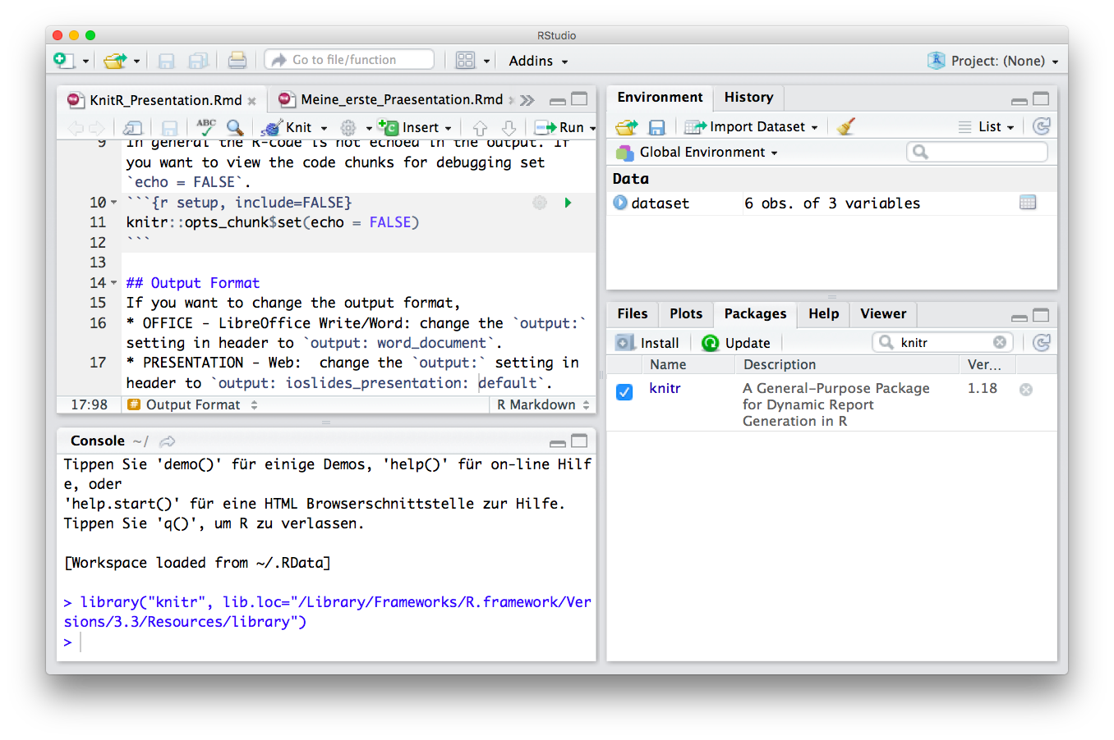

FROM EXCEL TO R
R & FRIENDS
R
R
Studio
Scripting / Programming Language
Objects in Environment
R-scripts (Save Your Code)
Console (Run and Test Code)
Overview by Type, Help and R-packages
Reports (html, pdf, latex)
R Code Interpreter and Editor
8
Notes:
Markdown is a plain text language with formatting syntax designed so that it can be converted to HTML and many other formats.
They are written using an extension of markdown syntax that enables R code to be embedded in them in a way which can later be executed.
Knitr takes a plain text document with embedded code, executes the code and 'knits' the results back into the document.

Slide 11
FROM EXCEL TO R
THE ANATOMY OF R
R
Studio
.R
.Rmd
R
package
Function
Arguments
Editor
Scripts
Code documents
Bundle of functions
and packages
Reproducible code
Arguments as input
Input args. X, Y
Output Z
R
Language
9
Notes:
A double is a double-precision, 64-bit floating-point data type. It accommodates 15 to 16 digits, with a range of approximately 5.0 × 10−345 to 1.7 × 10308

Slide 12
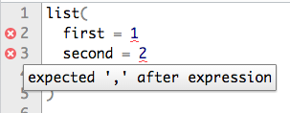
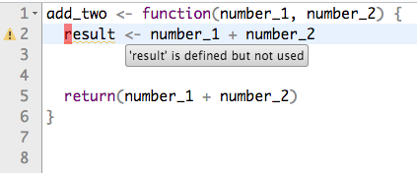
FROM EXCEL TO R
FIRST TIME IN R?
PACKAGES & FUNCTIONS
?my.package, ?my.function
What is it? Input?
install.packages(), remove.packages()
WORKING DIRECTORY
setwd(), getwd(), list.files(), list.dirs()
Were am I working from? Full/relative path.
?
SAVE YOUR WORK
.R, (or .Rmd)
The file with my code. Save it!
R project
Save Session, everything together
R
TIPS
Arrows to find the code you ran
R studio tips: view, diagnostics
Auto-complete with tab
R-cheat sheets
(https://rstudio.com/resources/
cheatsheets/)
RUN CODE
Run button, highlight enter, short-cut
10

Slide 13
1. R Project
File —> New Project —> New/Existing —> Create Project
FROM EXCEL TO R
R STUDIO BASICS
2. Set Path
getwd() - Get directory
setwd() - Set directory
setwd(“/Users/Tom/Rstuff”) - Full path
setwd(“./Rstuff”) - Relative path
Session —> Set Working Directory —> Choose Directory
R
Studio
3. R Script
Script Icon —> R Script —> File —> Save as …
4. Install and load a R package.
install.packages(“my.package”)
library (my.package) - Load package.
Tools —> Install packages —> my.package
11

Slide 14
FROM EXCEL TO R
ONLINE RESOURCES FOR R
https://www.r-project.org/
GET STARTED
GRAPHICS
BOOKS & COURSES
OTHER RESOURCES
https://rseek.org/
https://rstudio.com/resources/cheatsheets/
http://www.cookbook-r.com/
https://www.statmethods.net/r-tutorial/index.html
https://www.r-bloggers.com/best-books-to-learn-r-programming/
https://www.datacamp.com/
https://www.codecademy.com/
https://www.coursera.org/
https://github.com/trending/r
https://blog.revolutionanalytics.com/
https://stackoverflow.com/questions/tagged/r
https://www.r-graph-gallery.com/
http://r-statistics.co/Top50-Ggplot2-Visualizations-MasterList-R-Code.html
12

Slide 15
DATA STRUCTURES
DATA TYPES
Vector
Numeric
Age
-1.5, 2.7, 3.2
Data Frame
Age
Height
BMI
Integer
FROM EXCEL TO R
-2, -1, 0, 3, 5
R DATA TYPES & STRUCTURES
List
Character
“A”, “Bat”, “Tom”
VARIABLES
Array
Factor
OBSERVATIONS
G1, G1, G2, G3
Tibble
Logical
< >
< >
< >
< >
< >
TRUE, FALSE
13
Notes:
A double is a double-precision, 64-bit floating-point data type. It accommodates 15 to 16 digits, with a range of approximately 5.0 × 10−345 to 1.7 × 10308

Slide 16
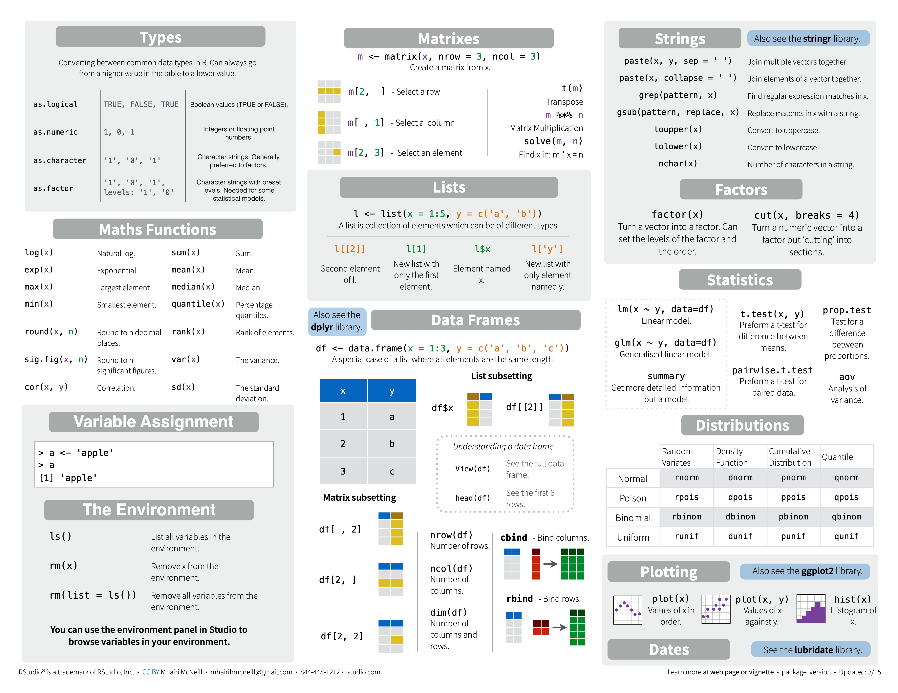
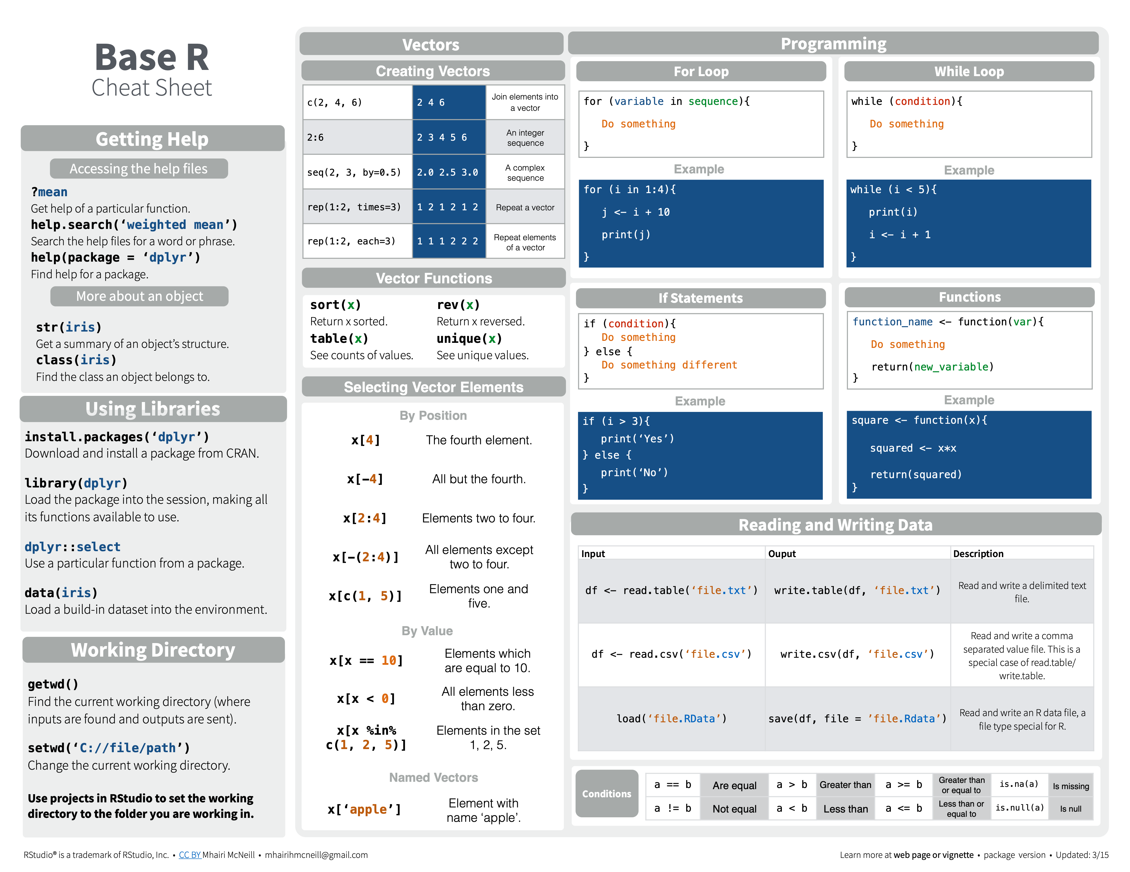
https://rstudio.com/resources/cheatsheets/
R BASE SYNTAX - RUN THROUGH
VARIABLE ASSIGNMENT
> x <- c(1.5, 2.6, 1.7, 3.2, 3.0, 2.9, …)
> x
> [1] 1.5 2.6 1.7 3.2 3.0 2.9 …
READING AND WRITING DATA
DON’T USE
Spaces in names
Special characters
% ? / | \ & $ @
Unspecific names
Short/long names
DO
14

Slide 17
https://rstudio.com/resources/cheatsheets/
R BASE SYNTAX - RUN THROUGH
SELECTING ELEMENTS
R-BASE FUNCTIONS
CONDITIONS
15

Slide 18
https://www.rstudio.com/wp-content/uploads/2016/10/r-cheat-sheet-3.pdf
BASE R CHEAT SHEET
Basics:
getwd(), setwd() # location
install.packages('pname'), library(pname)
ls(), rm() # list, remove objects
load(), data(), save() # load, save as .Rdata
Read in data:
read.xlsx('name.xlsx'), read.delim('name.txt', sep ='\t') read.csv('name.csv', sep=';')
GETTING
STARTED
Overview:
head(df, n=10), df[1:10,] tail(df, n=10)
# first or last 10 rows
class() # data structure
unique(), table() # unique vals, count vals
Make Data:
c() # vector
data.frame(x=x,y=y)
matrix(x, nrow = 3, ncol = 3))
list(x=x, y=y)
DATA STRUCTURES & OVERVIEW
CHUNK OPTIONS
Is/As type:
Strings:
paste(x, y, sep = '')
grep('pattern', x) # find str pattern
gsub('pattern', 'replace', x) # replace with
DATA TYPES & STRINGS
is.numeric(x) (character, factor, integer, etc.)
as.numeric(x) (factor, matrix, data.frame, etc.)
Other:
seq(1, 10, by = 1.0) # sequence from-to
rep(x, times) # replicate n times
sort(), reverse() # sort or reverse vector
Plots:
plot(x)
plot(x,y) # scatter
hist(x) # histogram
VECTORS &
BASE PLOTS
16

Slide 19

FROM EXCEL TO R
FROM EXCEL TO R
02
GETTING HELP
01
HOW TO
NOT FREAK OUT
WHEN LEARNING R
GETTING HELP
?
Ask us, and ask people next to you.
Look at the R presentations we go through.
Use the cheat sheets in this presentation and online: https://rstudio.com/resources/cheatsheets/
Remember, you are NOT suppose to remember commands by heart! No programmer does this.
Learning a programming language is like learning a real language - it takes practice, mistakes, …
Google it! Most important skill of all.
You will get the solutions to the exercises near the end of the day.
2

Slide 20
1
2
R project & R Script
Read & Write
Basic calculus
Base plot
R help
Save & Shutdown
3
FUNDAMENTALS
R
Studio
EXERCISE 1
4
5
17

Slide 21
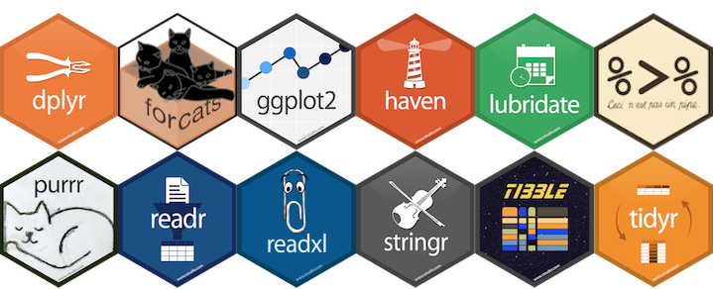
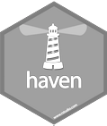

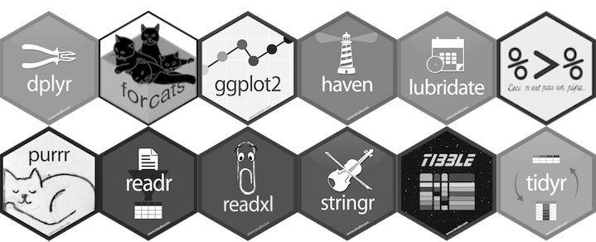
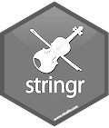
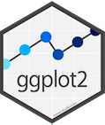
tidyverse is a collection of R packages for data science
READING DATA
“The packages share an underlying design philosophy, grammar, and data structures.” Wickham and Grolemund
TIDYING
https://www.tidyverse.org/
TIDYVERSE
MANIPULATION
tidyverse is used to “tidy up” your datasets, so they are easy to work with
PROGRAMMING
VISUALIZATION
18

Slide 22
https://www.tidyverse.org/
CECI N'EST PAS UNE PIPE
%>%
tidyverse
You do NOT have to “chose” between
tidyverse and base R
base R
base R
# think from the inside out
g(f(x,y),z)
BENEFITS
?
CONSIDERATIONS
tidyverse
Short & well-organised code
Can be less stable
# no brain acrobatics
x %>% f(y) %>% g(z)
Tidy datasets, easy to work with
“Different syntax”
Great documentation
pipe symbol
Functions with logical names & inputs
Remember what tidyverse is made for!
19
Notes:
dpyr functions are like lego. You can add them however you want (in theory).

Slide 23
https://www.tidyverse.org/
TIDYVERSE CHEAT SHEET
readr, tidyr, dplyr, …
Read Data (readr)
Data Tidying (tidyr)
Data Manipulation (dplyr)
Reading tabular data
There are solutions for multiple data types
read_excel() # using readxl package
read_table()
read_csv()
Useful arguments
Skip lines: read_csv(file, skip=1)
Read subset: read_csv(file, n_max=1)
Data types
readr guesses the types of each column and tells you about it
(“Parsed with column specifications: …”)
Handle missing values
drop_na()
fill()
replace_na()
Subsetting
tibble[:,1:5] # returns a tibble
tibble$colname # returns a vector
(same as tibble[[colname]])
Reorganize layout
Change between long and wide format
gather() # wide to long
spread() # long to wide
Summary
summarise()/summarize()
count()
Group
group_by()
Functions will manipulate each group separately and combine results.
Extract and sort observations # i.e. rows
filter() # subset by condition
distinct() # subset to unique values
top_n() # subset by position
arrange() # sort low->high, other way with desc()
Manipulate variables # i.e. columns
select()
mutate(new_name = f(column))
Vectorised functions
Ranking: percent_rank()
Math: Any arithmetic or logical operations, between(), near()
if_else()
HELP
R Documentation (e.g. enter ?dplyr::filter and see examples)
Much more info and detailed cheat sheets:
https://brianward1428.medium.com/introduction-to-tidyverse-7b3dbf2337d5
It also helps to google “tidyverse + whatever_you_want_to_do”
20

Slide 24
1
2
TIDYVERSE
R
Studio
3
EXERCISE 2
4
Tidyverse:
Filtering
Selecting
Mutating
Arranging
Summarizing
5
21

Slide 25
https://github.com/aaronpeikert/reproducible-research
REPRODUCIBILITY IN R
REPRODUCIBLE ANALYSIS
Perform an analysis multiple times
COMMENTED SCRIPT
Recall your own code
Sharing code with collaborators
RMARKDOWN
Flexible report making
GITHUB
Sharing & version control
Salvage older code in case of mistakes
R environment control
DOCKER
Required for publication in journals
REPRODUCIBILITY
22

Slide 26
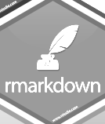
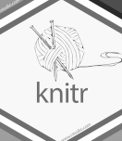
A markup language
Plain text format
Converted into HTML, PDF, LATEX
Finds code embedded in text
Evaluates the code
“Knits” the results into the document
https://www.markdowntutorial.com/
R SCRIPT & RMARKDOWN
HOW TO
HOW TO
Write text as normal
Embed code ```{r} my.code```
.R SCRIPT
Write code as normal
Comment text with #
.Rmd SCRIPT
USE FOR
USE FOR
Reports for yourself
Reports for collaborators
Tutorials
Testing new code
Big data analysis
Software development
23

Slide 27
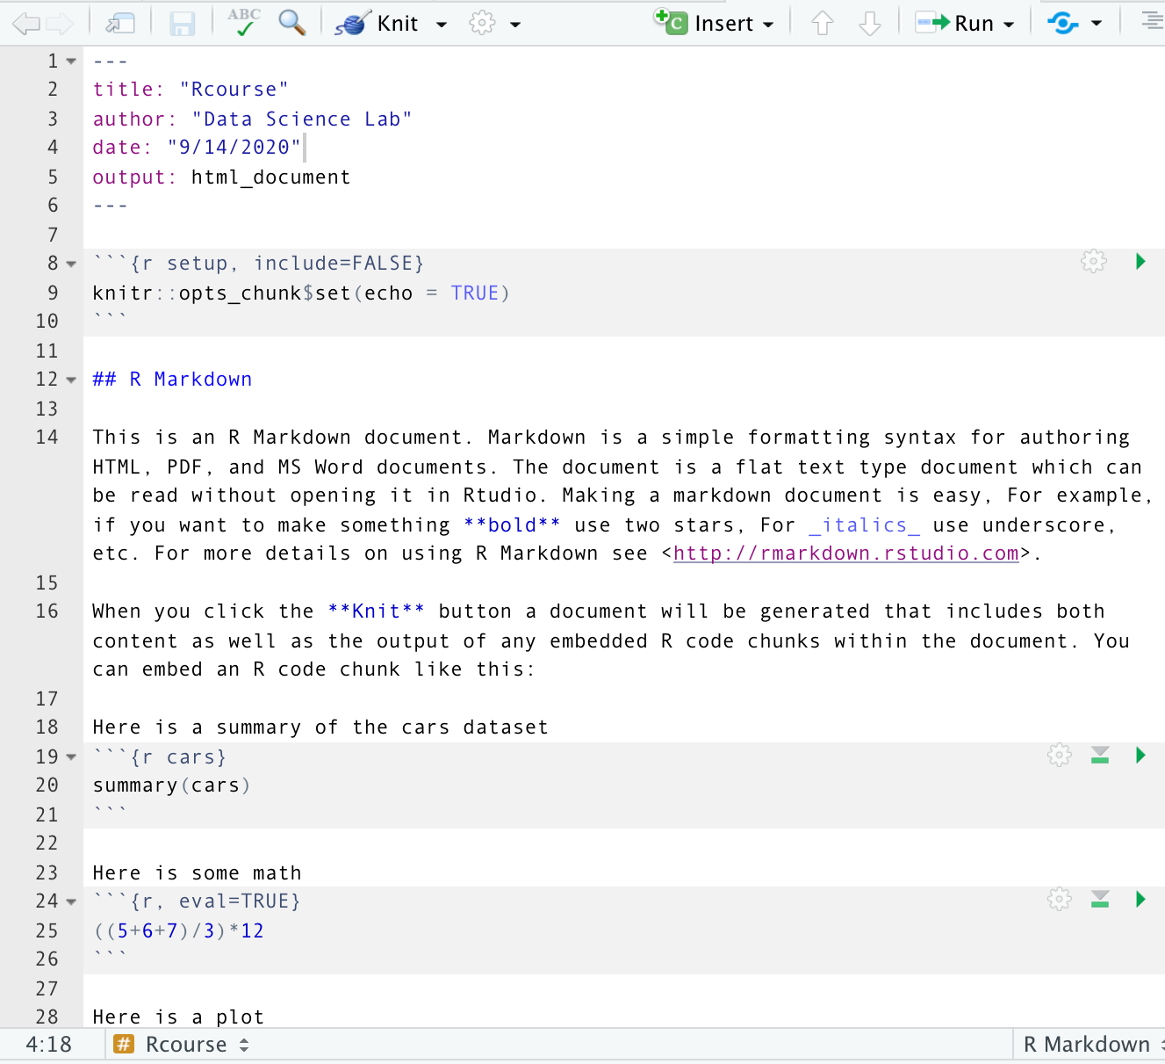
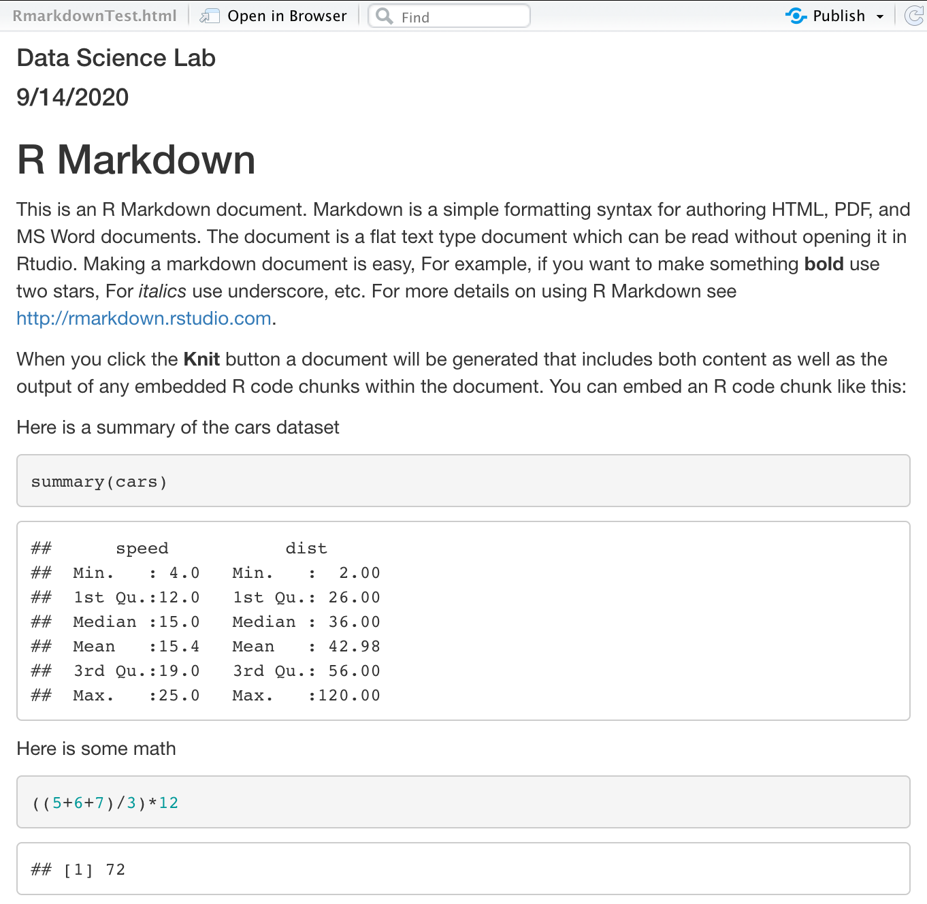
https://www.markdowntutorial.com/
RMARKDOWN
REPRODUCIBLE ANALYSIS
24

Slide 28
https://rstudio.com/wp-content/uploads/2016/03/rmarkdown-cheatsheet-2.0.pdf
RMARKDOWN CHEAT SHEET
Begin .Rmd:
---
title: My Project Name
output:
html_document (pdf_document, …)
---
Code Chunk:
Global Option:
```{r}
some R code
```
```{r setup, include=FALSE}
knitr::opts_chunk$set(echo = TRUE)
```
GETTING
STARTED
Code Options:
Figure Options:
echo (= TRUE or FALSE - print my code)
eval (= TRUE or FALSE - run my code)
warning (= TRUE or FALSE display warning messages)
fig.align (= 'left', 'right', 'center')
fig.cap (= 'my figure cation’)
fig.height (= n), fig.width (= n)
CHUNK OPTIONS
Header:
Text:
Lists:
Header size ranging from largest (one #) to smallest (six #):
# my.text, ## my.text, ### my.text, etc.
*italics*
**bold**
`highlighted`
List item1 (filled dot)
+ sub-item1 (open dot)
List item1 (numbered)
i) sub-item1 (roman)
TEXT
25

Slide 29
1
2
R MARKDOWN
R
Studio
3
EXERCISE 3
4
R markdown
Output
Syntax
Tables
Plots
Images
5
26

Slide 30
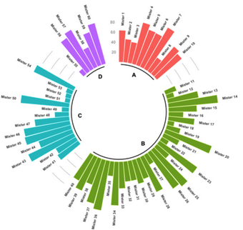
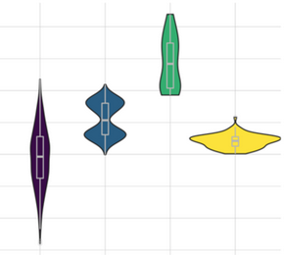
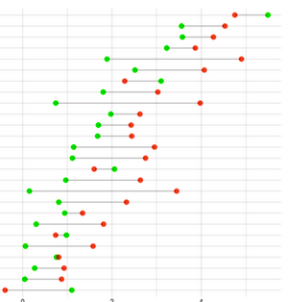
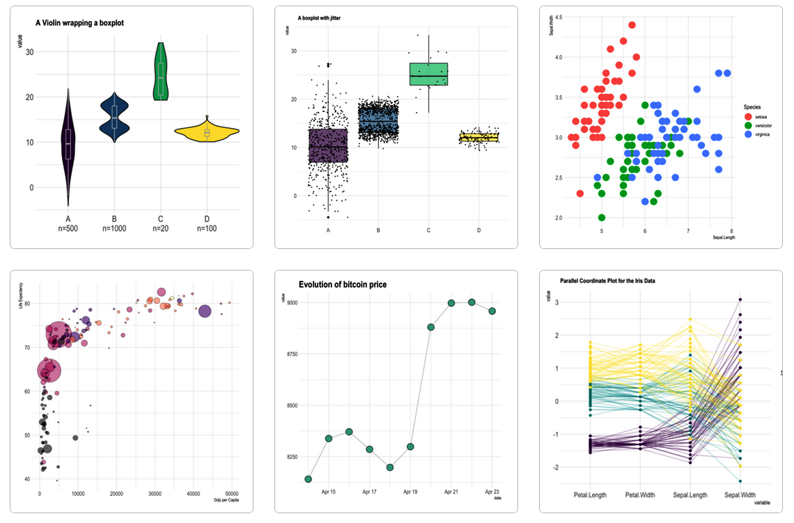

https://www.r-graph-gallery.com/
GGPLOT2 - EASY GRAPHICS
Aesthetically pleasing graphics.
Well-defined “additive” (+) structure.
Integrates perfectly with tidy data.
Great documentation & community
27

Slide 31

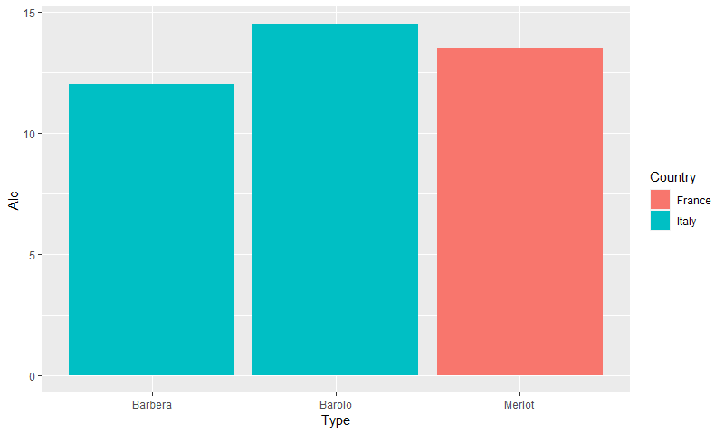
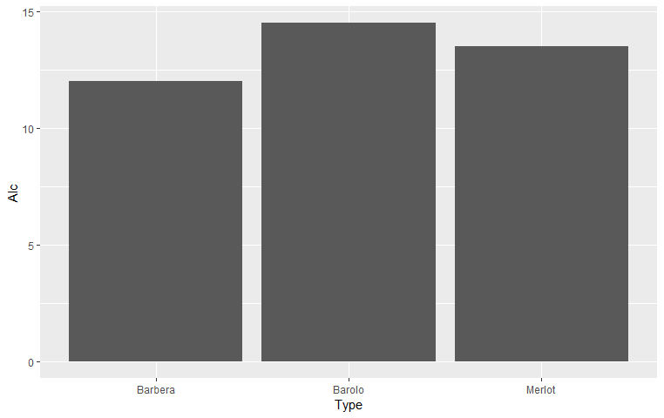
GGPLOT2 BASIC STRUCTURE
{
ggplot(my_wine, aes(...))
x = Type, y = Alc))
, fill = Country)) +
Type | Alc | Country | Flavonoids | Color
Barolo | 14.5 | Italy | 3.64 | 5.4
Barbera | 12.0 | Italy | 2.41 | 4.5
Merlot | 13.5 | France | 1.57 | 3.8
+
geom_col()
x – what's on the x-axis
y – what's on the y-axis
color – variable to base the color on
fill – variable to base the fill on
size – variable to base size on
shape – variable to base shape on

Slide 32
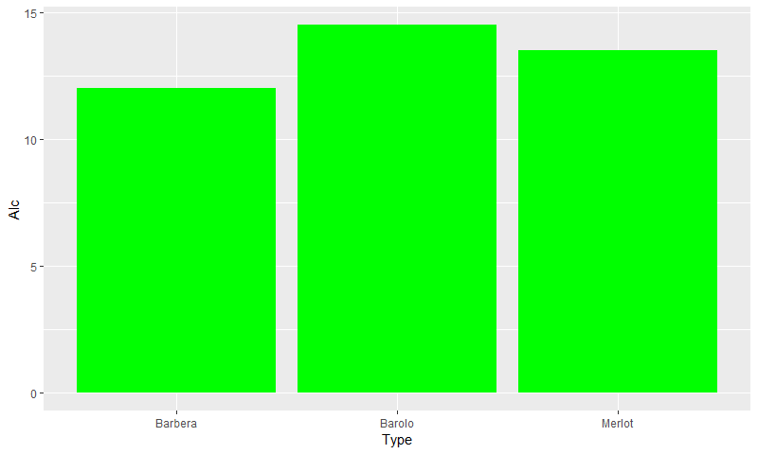
GGPLOT2 INHERITANCE AND THE AES
Geoms inherit the parameters from the ggplot they are added to
Alternatively, you can specify additional parameters directly in the geom
Things outside the aes apply to everything!
ggplot(my_wine, aes(x = Type,
y = Alc,
fill = country))
+ geom_col()
ggplot(my_wine, aes(x = Type,
y = Alc))
+ geom_col(aes(fill = Country))
ggplot(my_wine, aes(x = Type,
y = Alc))
+ geom_col(fill = 'green')

Slide 33
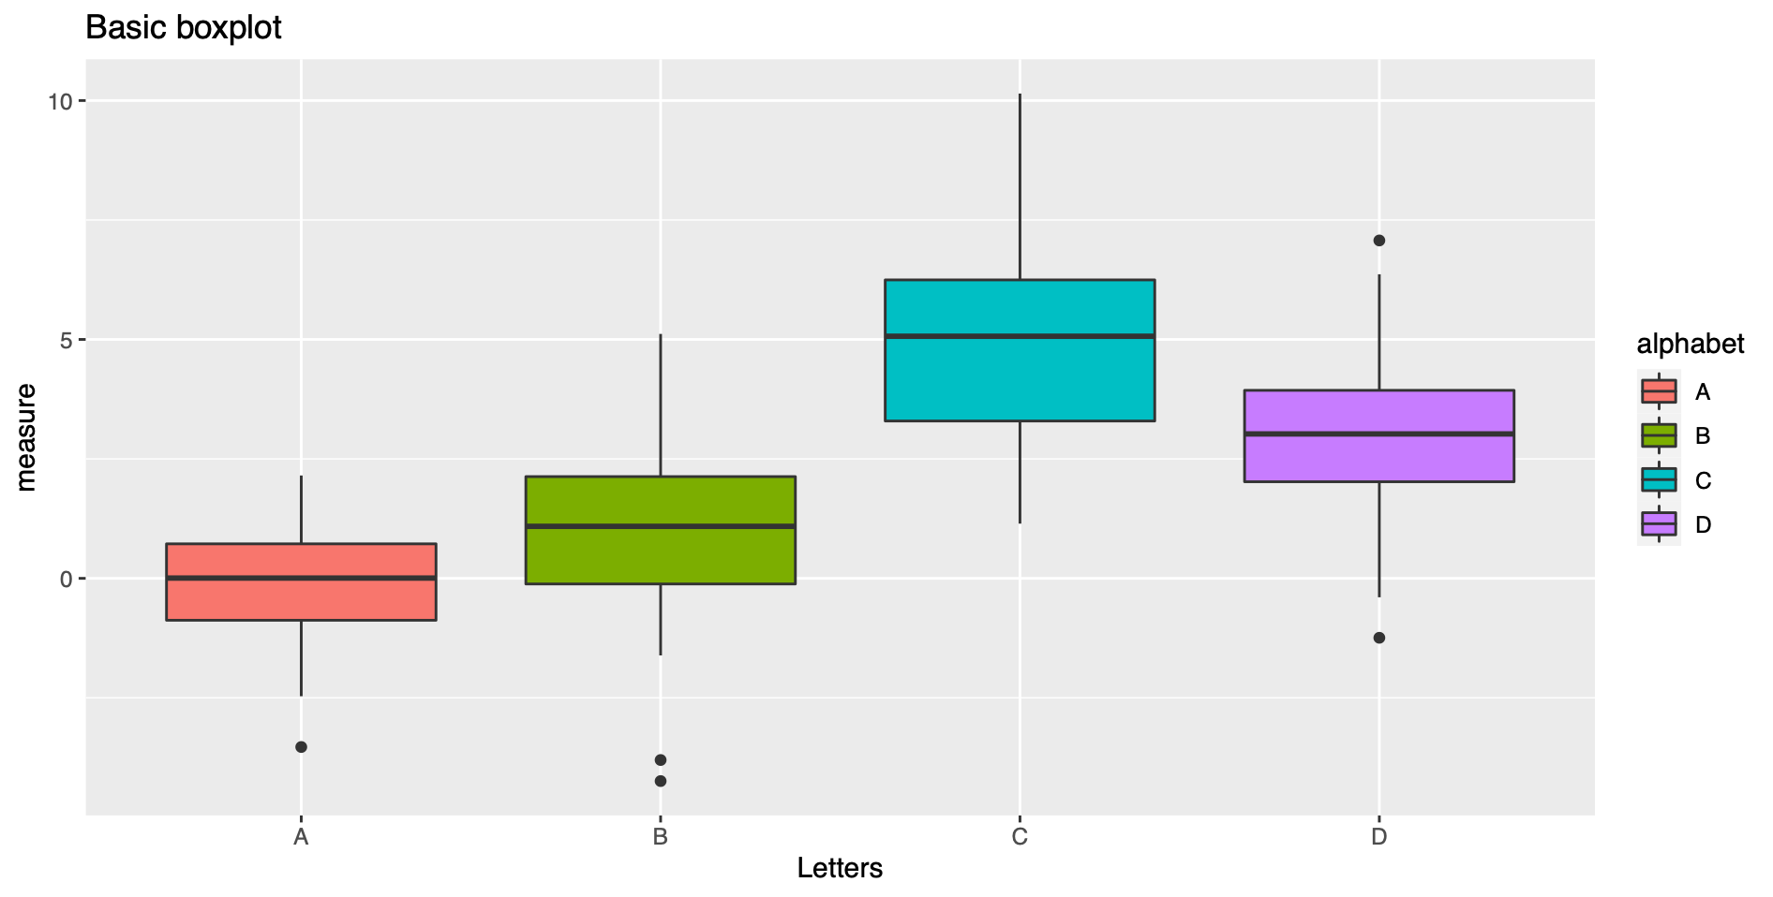
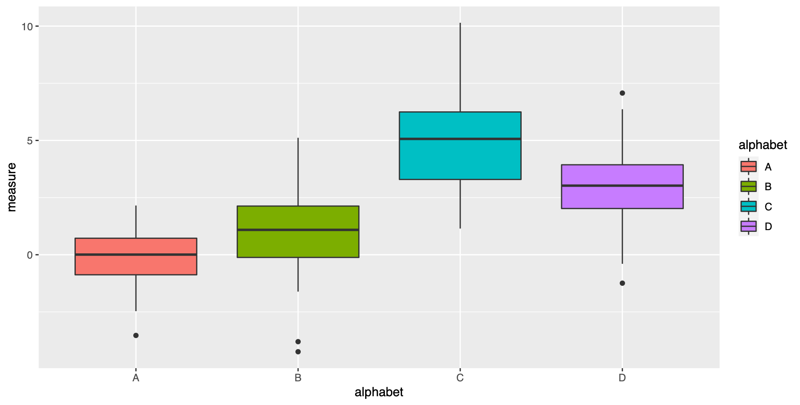
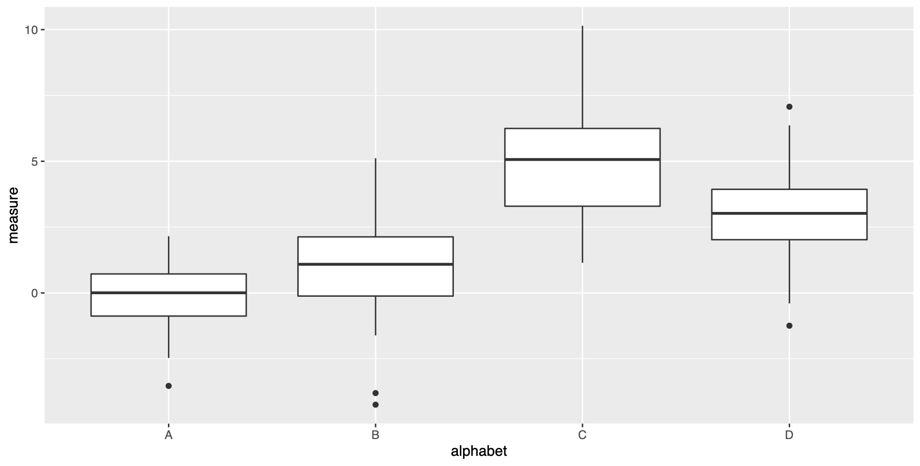
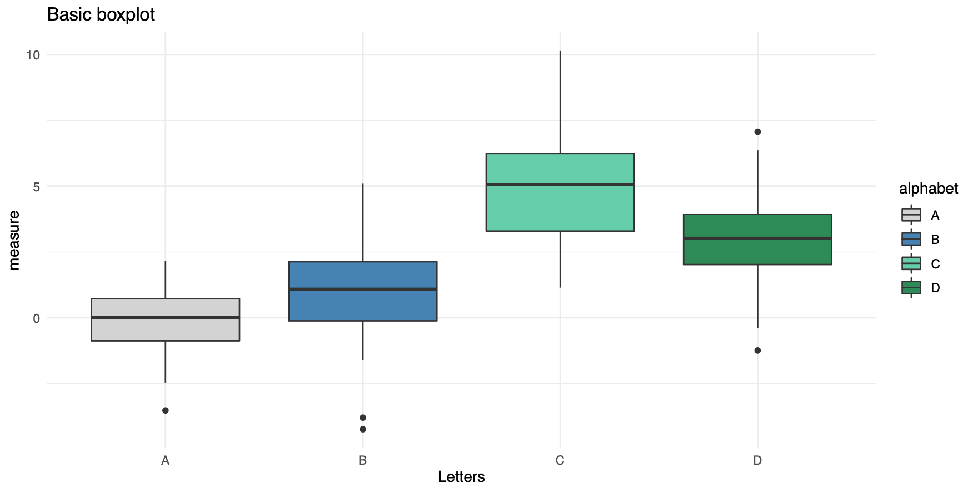
http://tutorials.iq.harvard.edu/R/Rgraphics/Rgraphics.html
DATASET, SAMPLES & OBSERVATIONS
ggplot(my.DS, aes(x=alphabet, y=measure))
GGPLOT2
ADDITIVE STRUCTURE
ggplot(my.DS, aes(x=alphabet, y=measure))
+ geom_boxplot()
DEFINE PLOT TYPE
ggplot(my.DS, aes(x=alphabet, y=measure, fill=alphabet))
+ geom_boxplot()
COLOR BY GROUP
… + ggtitle("Basic boxplot") + theme(legend.position=“none”, plot.title = element_text(size=11))
TITLE AND LEGEND
… + scale_fill_manual(values = c("lightgray", "steelblue",
“aquamarine3", "seagreen4"))
CUSTOM COLORS
BACKGROUND
+ theme_minimal()
28
Notes:
Aesthetic mappings describe how variables in the data are mapped to visual properties (aesthetics) of geoms.

Slide 34
DATASET, SAMPLES & OBSERVATIONS
ggplot(my.DS, aes(x=Sample, y=Measure))
GGPLOT2
ADDITIVE STRUCTURE
ggplot(my.DS, aes(x=Sample, y=Measure))
+ geom_boxplot()
DEFINE PLOT TYPE
ggplot(my.DS, aes(x=Sample, y=Measure, fill=Sample))
+ geom_boxplot()
COLOR BY GROUP
Sample | Measure
A | 0.2
A | -0.1
A | 0
B | 1.8
B | 0.5
… | …
… + ggtitle("Basic boxplot") + theme(legend.position=“none”, plot.title = element_text(size=11))
TITLE AND LEGEND
… + scale_fill_manual(values = c("lightgray", "steelblue",
“aquamarine3", "seagreen4"))
CUSTOM COLORS
THEME
+ theme_minimal()
28
Notes:
Aesthetic mappings describe how variables in the data are mapped to visual properties (aesthetics) of geoms.

Slide 35
https://rstudio.com/wp-content/uploads/2016/11/ggplot2-cheatsheet-2.1.pdf
GGPLOT CHEAT SHEET
Define Plot:
Add Plot Type:
+ geom_point()
+ geom_line()
+ geom_boxplot()
+ geom_col()
+ geom_density()
+ geom_histogram()
GET STARTED
ggplot(data = my.data, aes(x = x.var, y = y.var))
One Color:
Color Fill by Group:
Custom Colors:
ggplot(…, aes(…, color = “green”))
ggplot(…, aes(…, fill = group.var))
scale_*_manual(values = c())
ex: scale_color_manual(values = c(“blue”, “pink”))
COLORS
More Colors:
Grid Theme:
theme_bw()
theme_minimal()
theme_dark()
theme_*()
COLOR SCALES & THEMES
scale_fill_grey(start = 0.2, end = 0.8)
scale_fill_gradient(low="white", high=“red”)
Labels:
Text:
ggtitle(“…”)
xlab(“…”)
ylab(“…”)
theme(* = element_text())
theme(axis.title = element_text(angle = 90, colour= “red”), legend.text = element_text(size = 8, face = “bold”))
TEXT
29

Slide 36
1
2
R
Studio
3
GGPLOT2
ggplot2
Bar plot
Scatter plot
Boxplot
…
Syntax
Aesthetics
EXERCISE 4
4
5
30

Slide 37
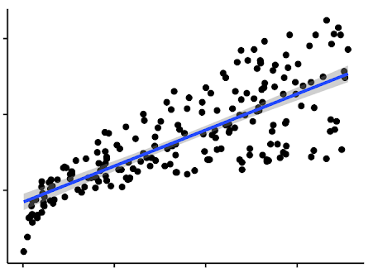
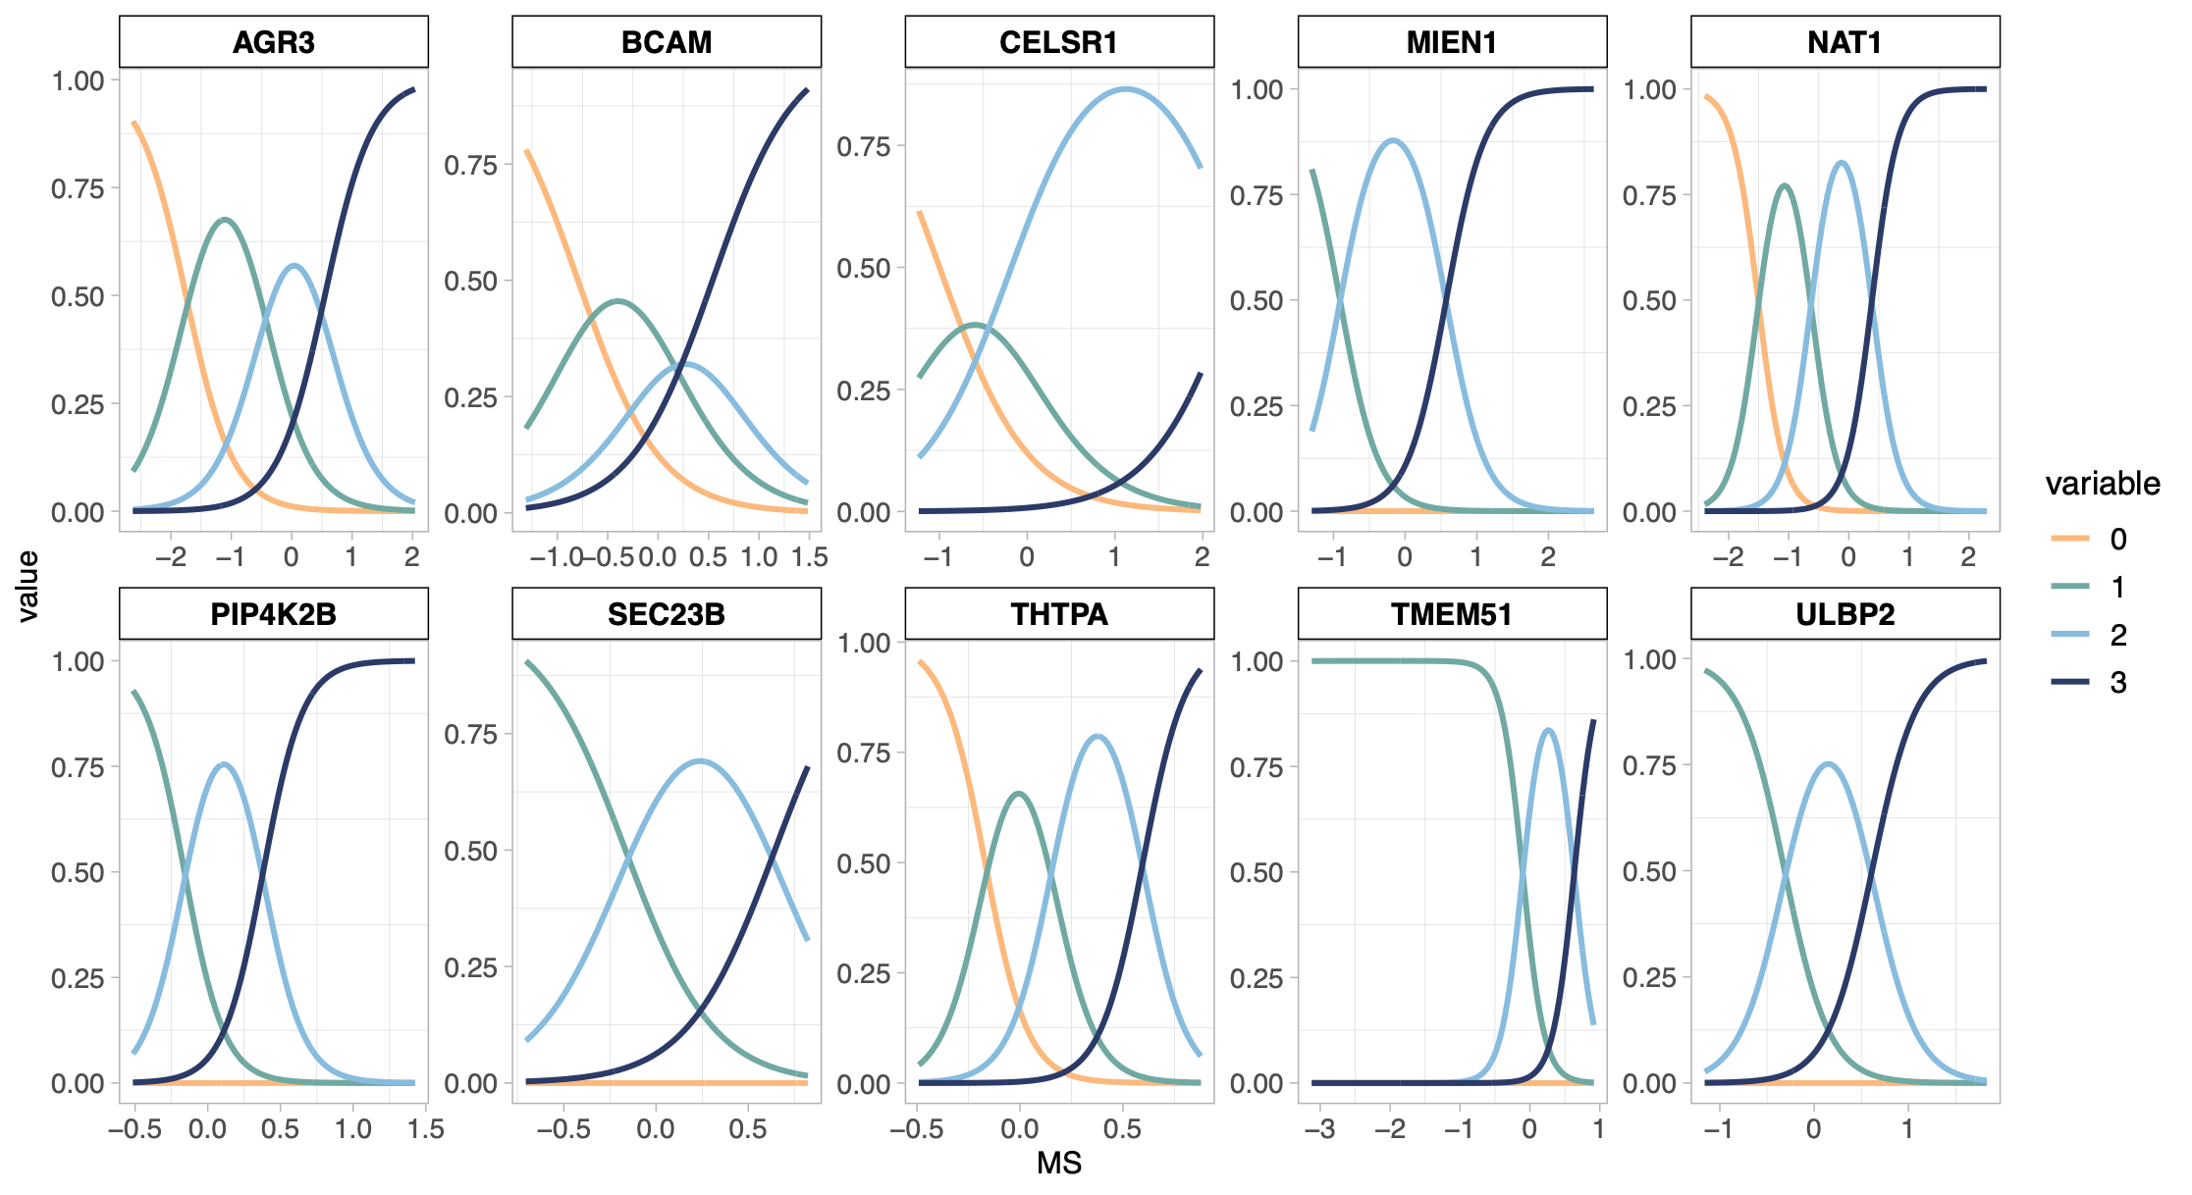
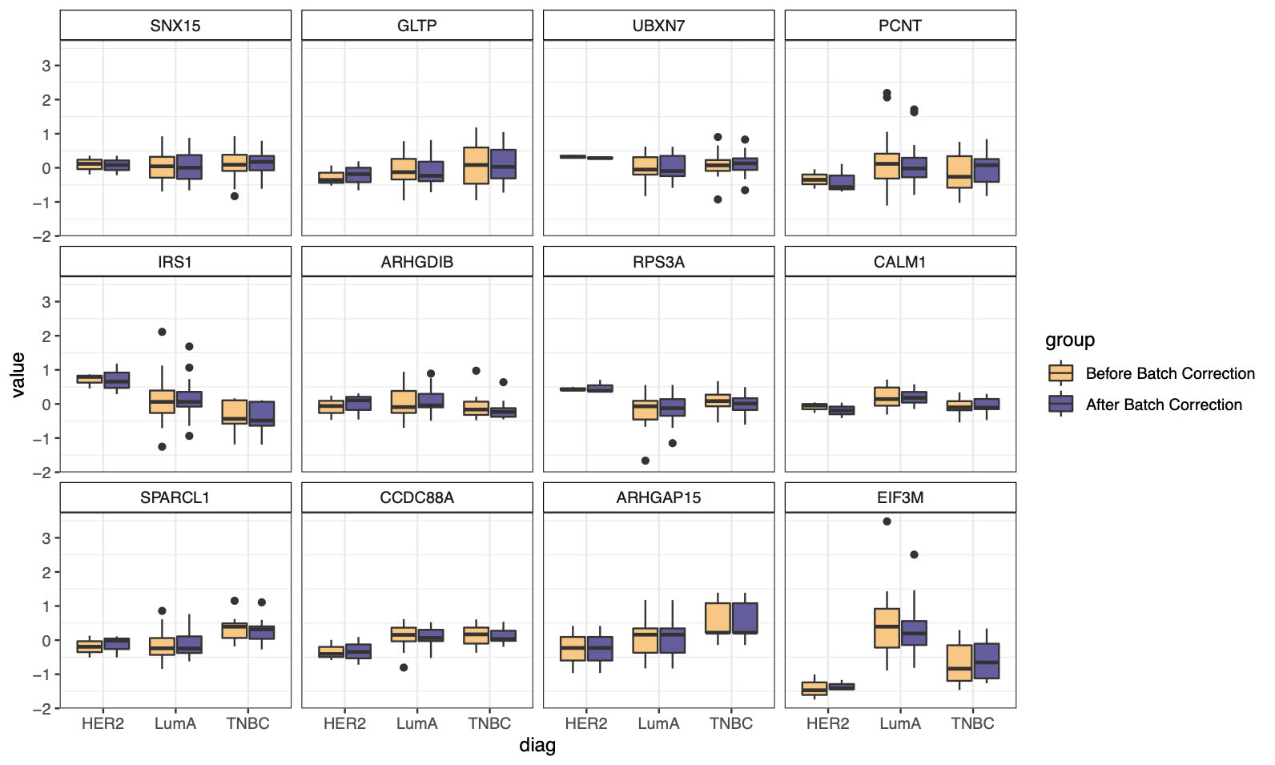
http://www.sthda.com/english/
R - A STATISTICAL
SCRIPTING LANGUAGE
Y
MODEL FUNCTIONS
lm(), glm()
lmer(), glmer(),
nls(), …
EMMEANS PACKAGE
emmeans(), pairs(), cld()
X
Variable 1
Variable 2
A
B
APPLY TO MODEL
MORE FUNCTIONS
summary(), anova(), confint(), predict(), drop1(), update(), step(), …
t.test(), cor(), cor.test(), aov(), quantile(), p.adjust(),
rank(), …
C
D
31

Slide 38

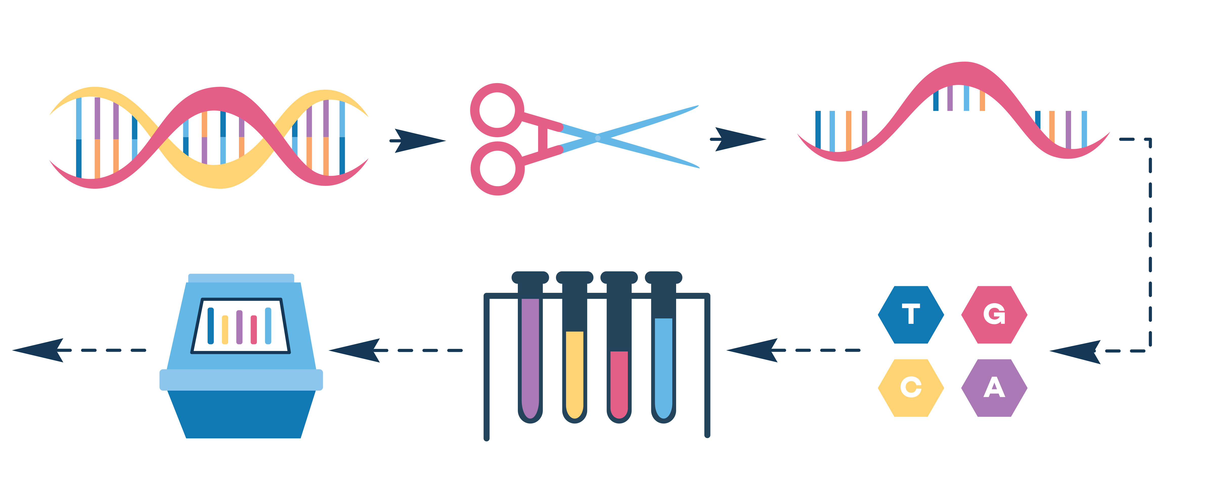

YOU
The researcher with R skills!
YOUR DATA
Gene expression data, i.e. how much a gene is used to produce a protein. Multiple genes measured in one experiment.
Let’s use R in a statistical analysis
YOUR DISEASE OF INTEREST
Psoriasis, an immune-mediated skin disorder.
33

Slide 39
http://www.sthda.com/english/
R - A STATISTICAL
SCRIPTING LANGUAGE
Y
During this session:
Cooperatively discuss and share ideas about the data
Apply steps of basic statistical analysis for hypothesis testing consistent with the given data
Suggest conclusions based on your analysis, regarding the association between psoriasis and gene expression levels
X
Variable 1
Variable 2
A
B
C
D
32

Slide 40
https://rstudio.com/resources/cheatsheets/ for various relevant cheat sheets.
Other example: https://www.dummies.com/programming/r/statistical-analysis-with-r-for-dummies-cheat-sheet/
STATS CHEAT SHEET
Import Data:
Overview of Data:
GET STARTED
read_excel(“my.data.xlsx”)
summary(my.data)
nrow(my.data)
length(my.data)
names(my.data)
Linear:
Logistic:
Linear Mixed:
Check Model:
summary(model) par(mfrow=c(2,2))
plot(model)
REGRESSION MODELS
lm(y~x, data=my.data)
confint(model)
glm(y~x,
data=my.data)
lmer(y~x + (1|z), data=my.data)
ANOVA:
F-Test:
Emmeans:
TESTS/COMPARISONS
anova(model2, model1)
drop1(model, test="F")
emmeans(model,~x)
pairs(emmeans(model,~x))
Check Type:
Change Type:
table(my.data$x)
is.numeric(my.data$x)
is.factor(my.data$x)
my.data <- mutate(my.data, x = factor(x))
my.data$z <- as.numeric(my.data$z)
VARIABLES
34

Slide 41
1
2
R
Studio
3
Statistics in R
EXERCISE 5
4
5
Linear regression
Summary Statistics
ANOVA
Logistic regression
Clustering
Correlation
35

Slide 42

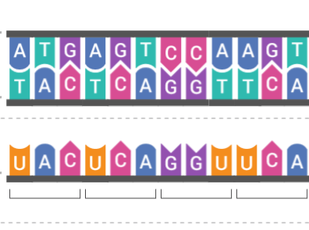
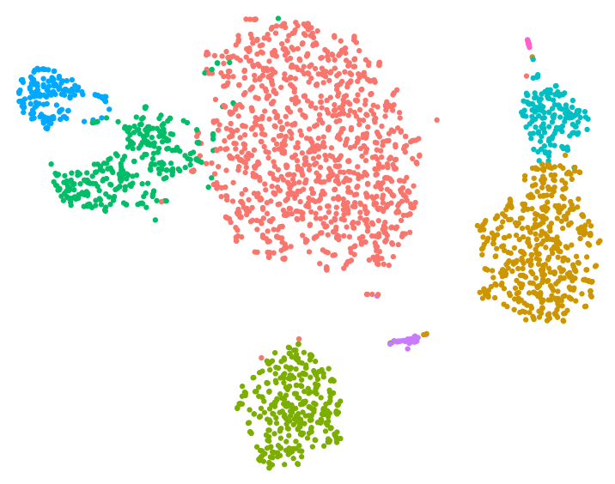
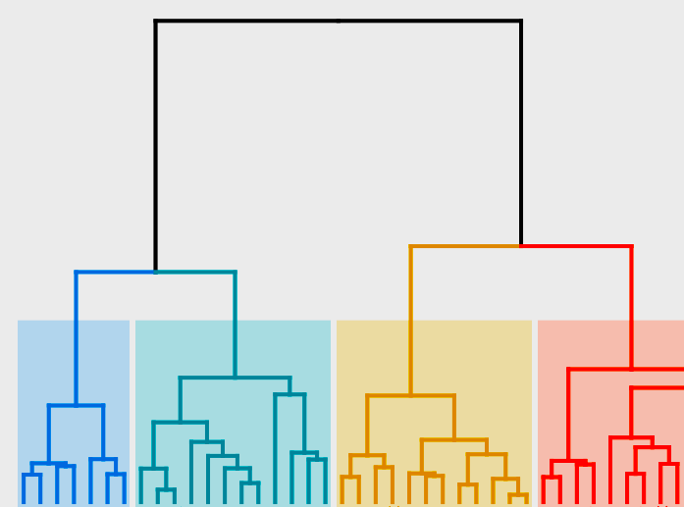
https://www.r-graph-gallery.com/
BIOINFORMATICS IN R
HIGH THROUGHPUT DATA
BIOINFORMATIC ANALYSIS
DIMENSIONALITY REDUCTION
CLUSTERING
DNA
RNA
PROTEIN
MACHINE LEARNING
NETWORK ANALYSIS
RNA SEQ DATA
PROTEOMICS DATA
36

Slide 43
FROM EXCEL TO R
THE TOP OF THE R ICEBERG
STATISTICAL ANALYSIS
DATA MANGEMENT
Statistical models (linear, generalized, mixed, …)
EASY PLOTTING
Statistical tests (t-test, chisq, anova, …)
Survival analysis (Cox, Kaplan meier)
BIOINFORMATIC ANALYSIS
R
37

Slide 44
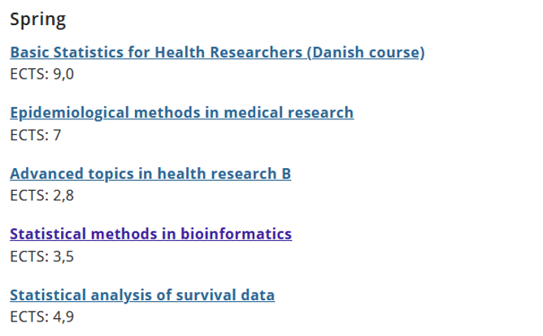
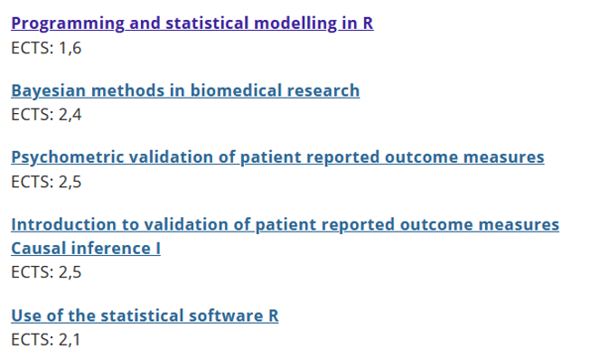
FROM EXCEL TO R
WANT MO-R-E?
The Section for Biostatistics offers a number statistics-oriented R courses:
https://publichealth.ku.dk/about-the-department/biostat/
* These are screenshots. Go to the website and scroll down to ‘Teaching’
38

Slide 45
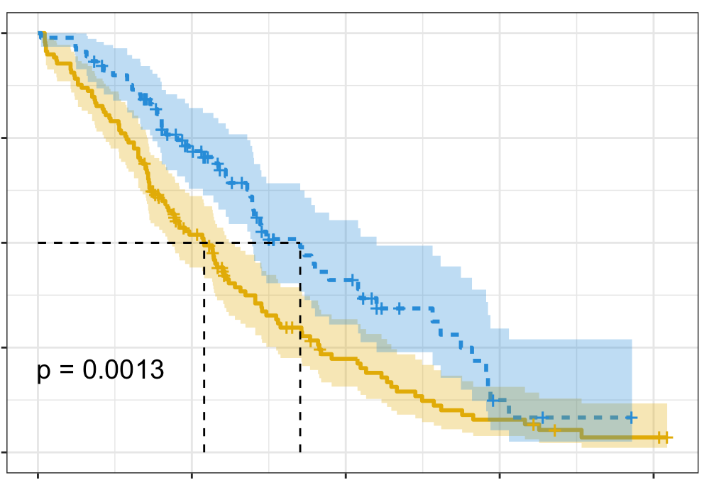
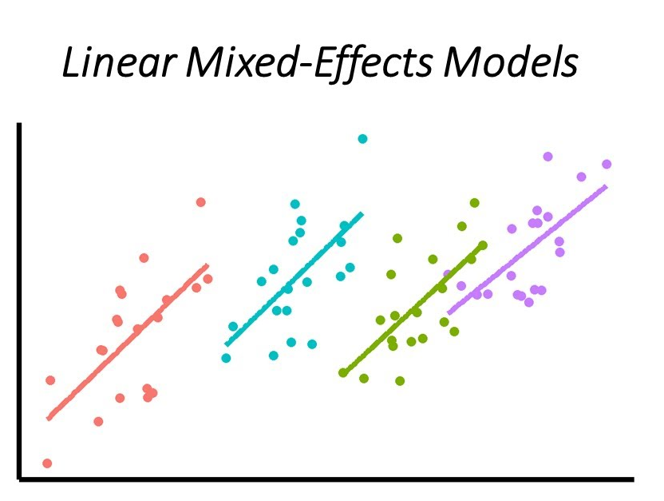
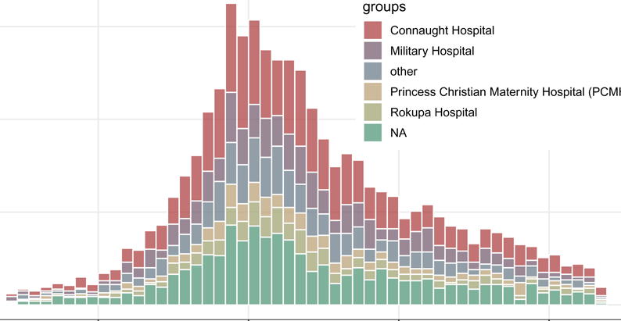
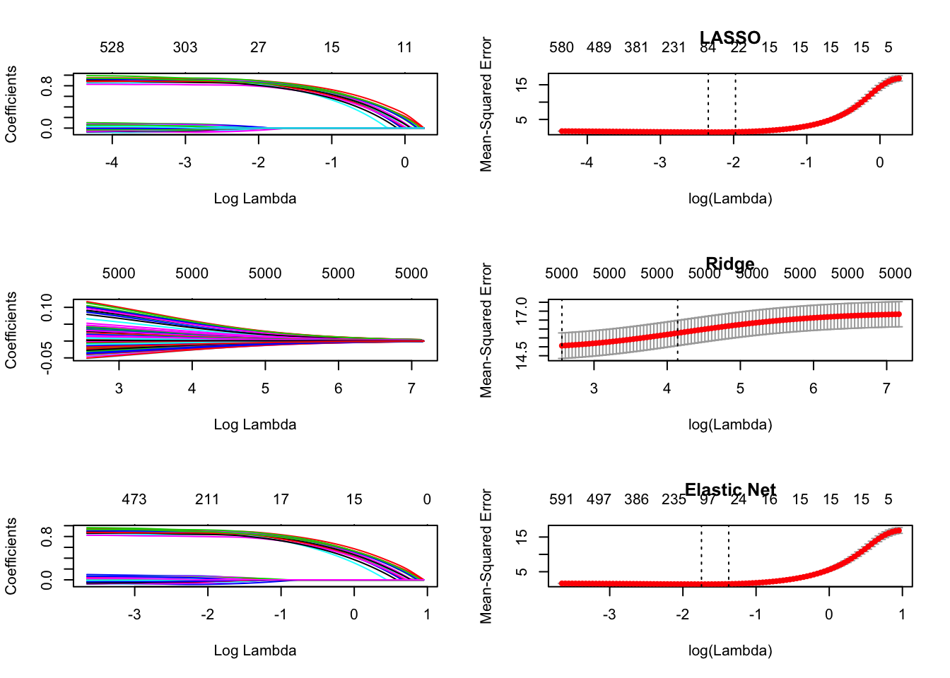
Survival Analysis
survival: https://rviews.rstudio.com/2017/09/25/survival-analysis-with-r/
survminer: https://cran.r-project.org/web/packages/survminer/survminer.pdf
(https://rpkgs.datanovia.com/survminer/ )
Mixed-Effects Models
lme4: https://cran.r-project.org/web/packages/lme4/vignettes/lmer.pdf
https://cran.microsoft.com/snapshot/2017-08-01/web/packages/sjPlot/vignettes/sjplmer.html
glmmTMB: https://cran.r-project.org/web/packages/glmmTMB/index.html
TEASER
STATISTICS in R
Epidemiological Analysis
Epi: https://cran.r-project.org/web/packages/Epi/index.html
pubh: https://rviews.rstudio.com/2020/03/05/covid-19-epidemiology-with-r/
https://cran.r-project.org/web/packages/incidence/vignettes/customize_plot.html
https://rviews.rstudio.com/2020/03/05/covid-19-epidemiology-with-r/
Elastic-Net Regression
glmnet: https://cran.r-project.org/web/packages/glmnet/glmnet.pdf
elasticnet: https://cran.r-project.org/web/packages/elasticnet/elasticnet.pdf
https://www.datacamp.com/community/tutorials/tutorial-ridge-lasso-elastic-net
21
39

Slide 46


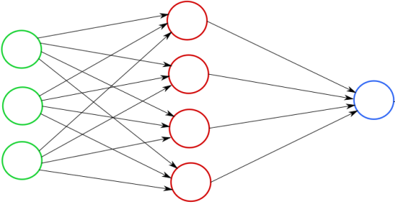
Clustering
Feature Selection: PCA
Missing Data
TEASER
Machine Learning
https://lgatto.github.io/IntroMachineLearningWithR/an-introduction-to-machine-learning-with-r.html
https://statsandr.com/blog/clustering-analysis-k-means-and-hierarchical-clustering-by-hand-and-in-r/
https://bioconductor.org/packages/release/bioc/vignettes/PCAtools/inst/doc/PCAtools.html
https://amices.org/mice/
https://datascienceplus.com/imputing-missing-data-with-r-mice-package/
Random Forest
kNN
SVM
Neural Networks
https://www.blopig.com/blog/2017/04/a-very-basic-introduction-to-random-forests-using-r/
https://www.edureka.co/blog/knn-algorithm-in-r/
https://cran.r-project.org/web/packages/e1071/vignettes/svmdoc.pdf
https://keras.rstudio.com/
https://tensorflow.rstudio.com/
40

Slide 47
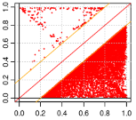
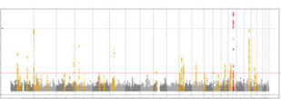







GWAS - QC &
Data Harmonization
GWAS Data Management & Plots
More Plotting…
EasyQC: https://www.uni-regensburg.de/medizin/epidemiologie-praeventivmedizin/genetische-epidemiologie/software/
EasyStrata: https://www.uni-regensburg.de/medizin/epidemiologie-praeventivmedizin/genetische-epidemiologie/software/
Manhattan and QQ plots: https://cran.r-project.org/web/packages/qqman/vignettes/qqman.html
TEASER
Omics Data
http://www.bioconductor.org/packages/release/BiocViews.html
Gene Expression Analysis
Proteomics Analysis
Single-Cell RNASeq
DESeq2, limma, EdgeR, etc.: http://www.bioconductor.org/packages/release/BiocViews.html#___RNASeq
RforProteomics: http://www.bioconductor.org/packages/release/BiocViews.html#___Proteomics
RforProteomics.html
https://cran.r-project.org/web/packages/e1071/vignettes/svmdoc.pdf
41

Slide 48






PLOTTING IN 3D
DEEP LEARNING
BAYESIAN STATISTICS
FROM EXCEL TO R
https://plotly-r.com/d-charts.html
https://keras.rstudio.com/
https://tensorflow.rstudio.com/
https://mc-stan.org/users/interfaces/rstan
COOL STUFF IN R
WEBPAGE WITH R SHINY
INTERACTIVE PLOTS
MAIL AND MESSAGES
https://shiny.rstudio.com/
https://gganimate.com/articles/gganimate.html
https://github.com/briandconnelly/pushoverr
42

Slide 49








SUND Data Lab
Courses
Workshops
Consultancy
Referrals
SUND
DATA LAB
Visibility
Seminars Symposiums
Individual
Training
https://heads.ku.dk
datalab@sund.ku.dk
CONSULTATION
TECHNICAL ASSISTANCE
INDIVIDUAL TRAINING
RDM
CRO
Commissioned Research
42

Slide 50


SUND Data Lab
HeaDS Offering 2023
General Programming courses
R language
Python
Bash /Command line
More specialized
Data protection, GDPR
RNA-Seq
Computerome
Git and GitHub
Pre-processing
Quality Control
Integration
Normalization
Clustering
Differential Analysis
42

Slide 51
SUND Data Lab
Commissioned Research
We perform
some or all of the analysis.
Data processing
Statistical analysis
Report , Visualization and interpretation
Code for GitHub
Pre-processing
Quality Control
Integration
Normalization
Clustering
Differential Analysis
Payment scheme and/or co-authorship - 500 DKK/hour
It is NOT a
Collaboration
42

Slide 52

THANK YOU FOR LISTENING
42

Slide 53
THANK YOU FOR LISTENING
This keynote presentation was created by Thilde Terkelsen, Data Scientist, Center for Health Data Science, SUND, KU.
For internal use at KU only, do not distribute commercially.

Slide 54

NETWORKING EVENT
Tags
Just outside!
Topic
i.e. chromatin organization, cardiovascular disease
Technique
i.e. RNAseq, mass spectrometry

Slide 55



HEADS EVENTS
We want to hear from you!
What type of event(s) are you interested in?
https://ucph.padlet.org/henrikezschach1/headsevents

